Slide 1
MyFleetManager Pro
A presentation by the C# Shooters

Slide 2

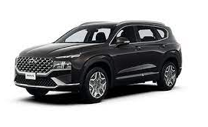
Intended for use by Fleet Managers.
An important part of fleet management is keeping track of how much vehicles consume in terms fuel and money.
Keeps track of fleets, drivers, vehicles and fuel transactions and returns details in a report.

Slide 3
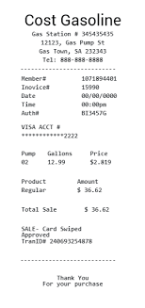

Overview
Automatic fuel transaction capturing software
Automates the process of capturing fill-up data and analysis.
Makes use of an AI Optical Character Reading (OCR) Scanner trained to pull details from images.
Generate fleet management reports by scanning fuel-up receipts.

Slide 4

Tech Stack
ASP.NET
HTML
C#
SQL Server Management Studio

Slide 5
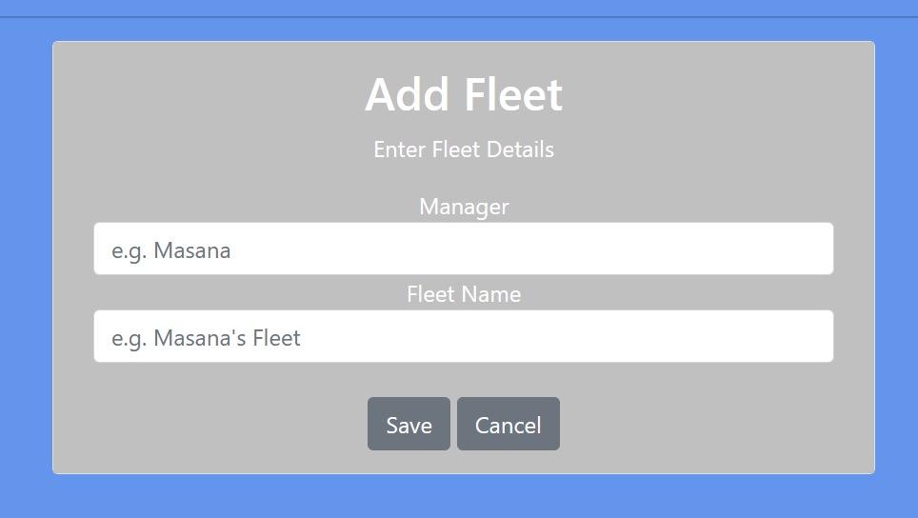
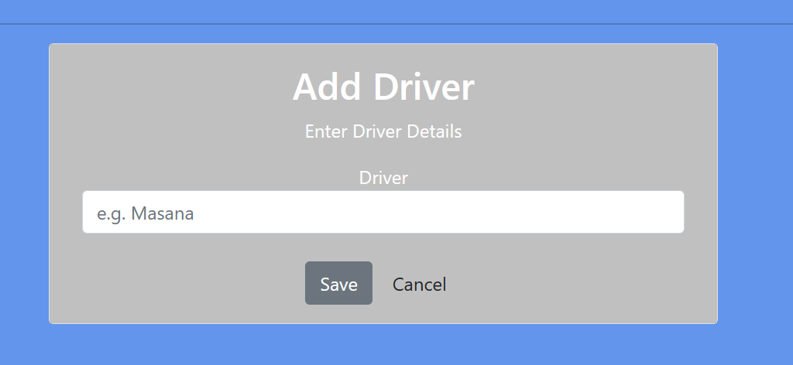
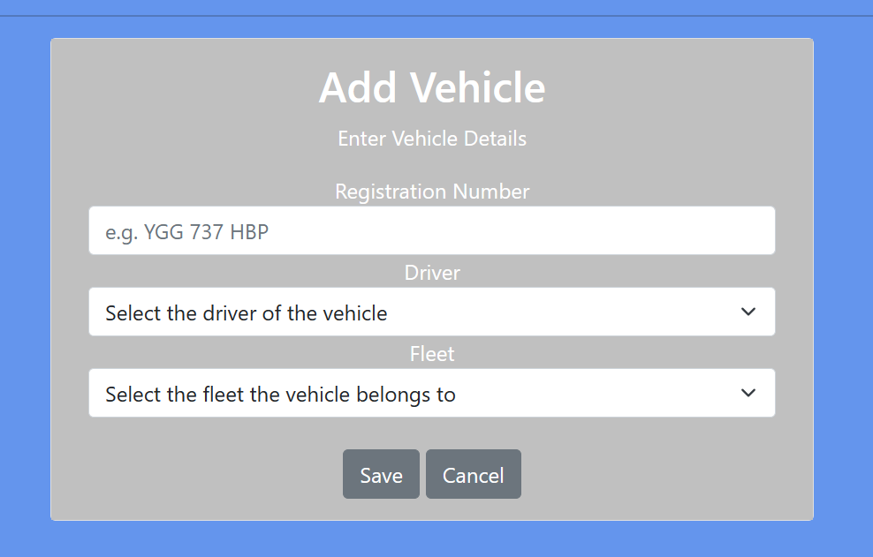
Detail Entry

Slide 6
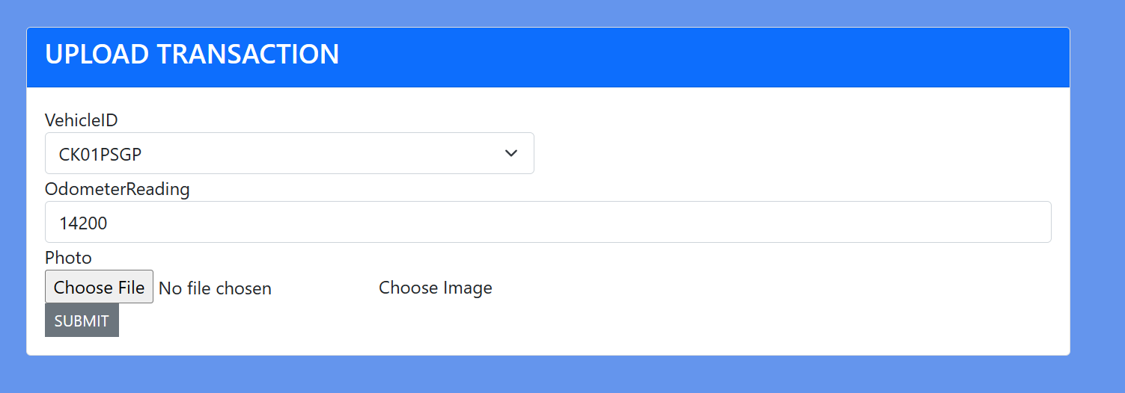
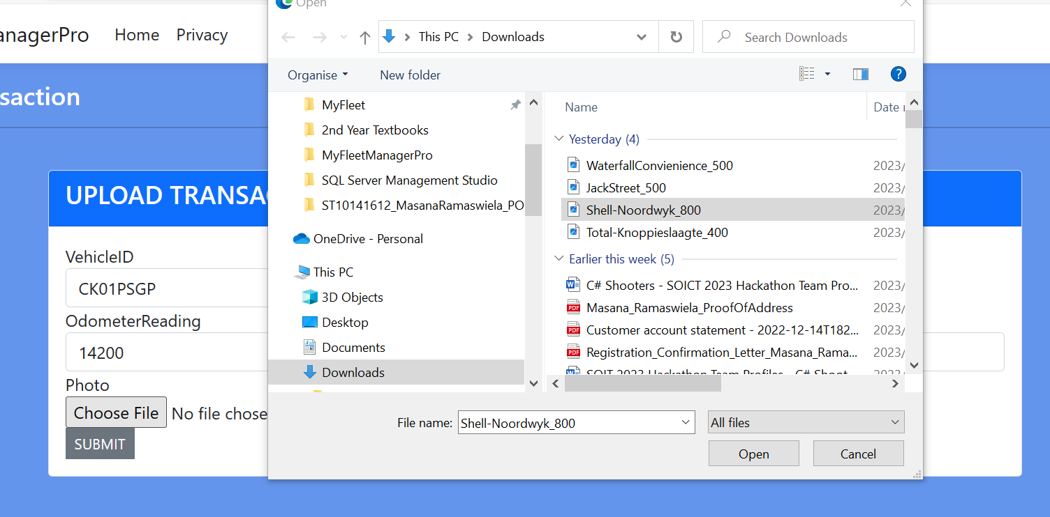
Scanning

Slide 7
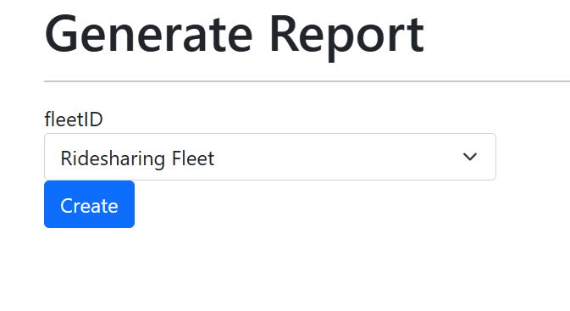

Slide 8
